Slide 1

Office of the National Water Resources

Slide 2
Water Resources Management Strategic Plan

Slide 3
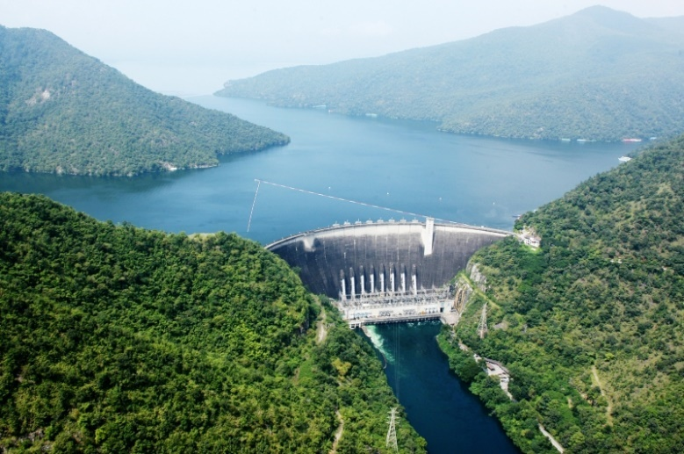
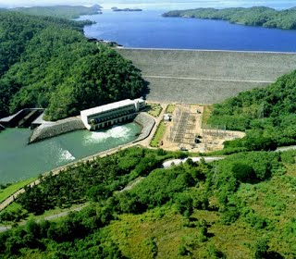
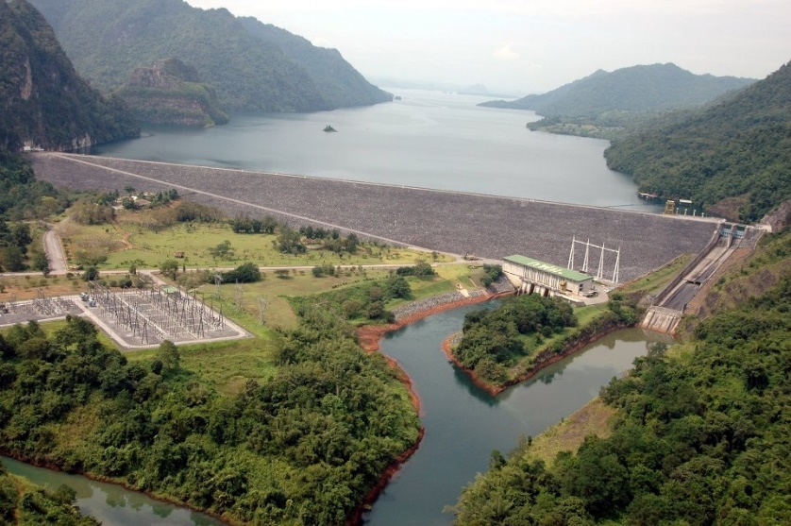



Water Resources Management Strategic Plan
Office of the National Water Resources
Nitiphan Trongkarndee
3

Slide 4

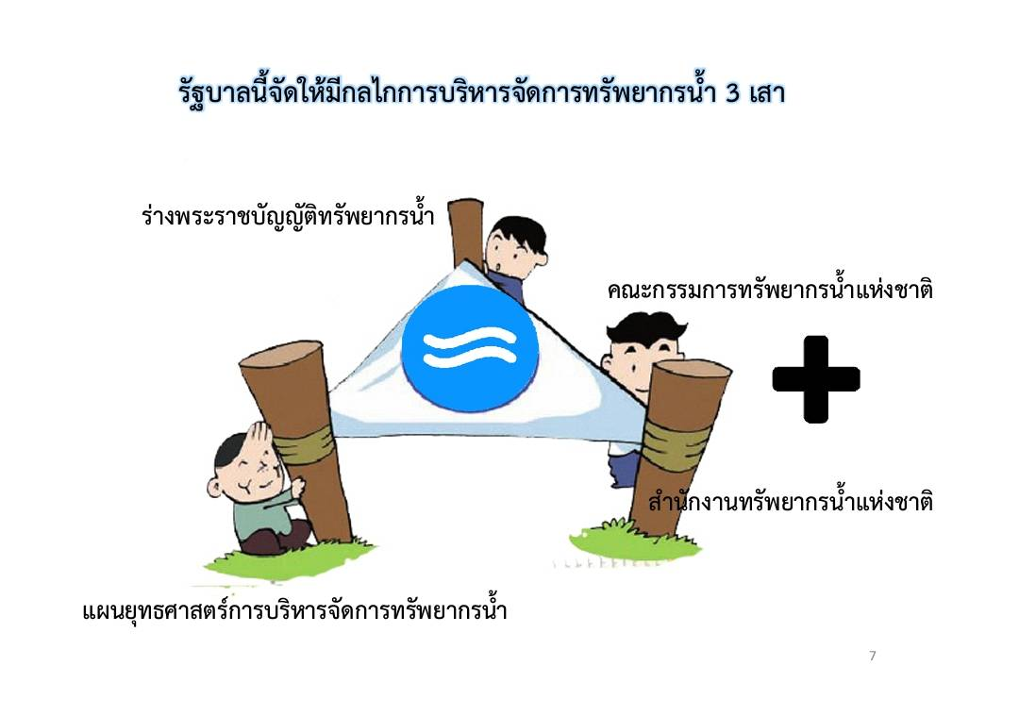
Water Resources Management Mechanism
3 Mechanisms of Water Resources Management
Draft of Water Resources Act
The National Water Resources Committee
Office of the National Water Resources
Water Resources Management Strategic Plan
4

Slide 5




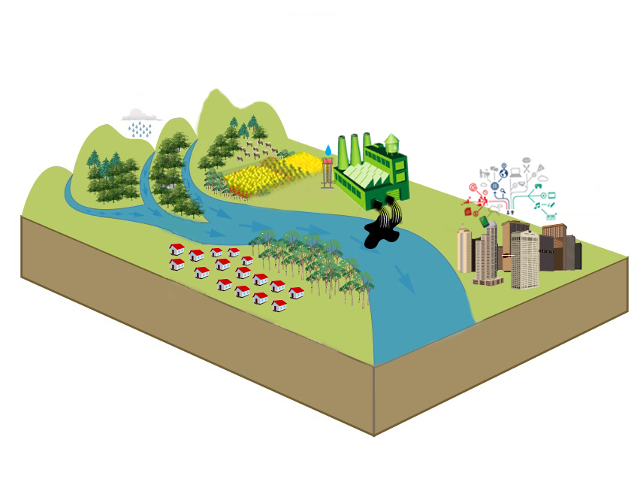





Water Resources Management Strategy 2015-2026
Creation for
Water Security for Production
(Agri. + Ind.)
Water Quality Management
Upstream Forest Conservation and Soil Erosion Prevention
Water Management for Consumption
Administrative Management
Flood Management
5

Slide 6

Lesson learned
Water Resources Management for Consumption
250 / 7,490 difficult villages (Upstream village, Rain harvest, Good ground water quality)
Next Step => Water Quality
Creation for Water Security for Production(Agriculture/Industry)
5.4 up to 8.5 Million Ha. / EIA / Budget
Next Step => Supply VS Demand
Flood Management
Budget 150,000 Million Baht (4.3 Million USD) / EIA / SEA / Public Participation
Next Step => Nonstructural Measure / Flood Management
Water Quality Management
Industrial Sector Treatment
Next Step => Water quality from city
Upstream Forest Conservation and Soil Erosion Prevention
Forest Conservation 31.5%(41.3 Million Ha.) up to 40% (52.6 Million Ha.)
0.12 Million Ha. in 3 years
Administrative Management
12 yr. to 20 yr. Strategy
Target Budget / Set Priority
The National Command Center
Next Step => Public Participation for Water management
6

Slide 7
Drought Management in 2017/18

Slide 8

Drought definition
Meteorological
Hydrological
Agricultural
Socio-Economic
Thai Meteorological Department
Rainfall deficit &
Length of dry period
Lacking of water
Causing dryness and affects to communities
Department of Disaster Prevention and Mitigation
Declined water
supply
Lacking of sufficient available water for domestic use
Affecting to crop yield
Causing losses and impact communities, society and economy
Impact on crop growth and yield
Land Development Department
Sub-average rainfall or deviation in seasonal rainfall patterns
Causing in water supply deficit for domestic and agricultural uses
Effecting crop growth and yield
Leading to socio-economic drought
Demand for economic goods exceeds supply
Source: National Oceanic and Atmospheric Administration
8
Notes:
Countries throughout the world have experienced drought in many different patterns. Drought measurements vary based on its drivers and impacts.
Meteorological drought happens when there is a comparatively high degree of dryness and the duration of the dry. This definition is considered a region specific since the atmospheric conditions are highly variable from region to region.
Hydrological drought occurs when low water supply is evident, particularly after a long period of meteorological drought. The frequency and severity of hydrological drought is often defined on a watershed or river basin scale.
Agricultural drought happens when crops become affected.
กรมอุตุนิยมวิทยา ได้กำหนดนิยาม ภัยแล้ง คือ “ภัยที่เกิดจากการขาดแคลนน้ำในพื้นที่ใดพื้นที่หนึ่งเป็นเวลานาน จนก่อให้เกิด ความแห้งแล้ง และส่งผลกระทบต่อชุมชน” (กรมอุตุนิยมวิทยา, 2557) กรมป้องกันและบรรเทาสาธารณาภัย “ภัยที่เกิดจากการขาดแคลนน้ำดื่ม น้ำใช้ พืชพันธุ์ไม้ต่างๆ ขาดน้ำ ไม่สามารถเจริญเติบโตได้ตามปกติ ในพื้นที่ใด พื้นที่หนึ่งเป็นเวลานาน จนก่อให้เกิดความเดือดร้อนเสียหาย และส่งผลกระทบอย่างกว้างขวางต่อชุมชน สังคม และระบบเศรษฐกิจโดยรวม”
กรมพัฒนาที่ดิน “ภัยธรรมชาติ อันเกิดจากการมีฝนตกน้อยหรือฝนไม่ตกต้องตามฤดูกาลทำให้เกิดสภาวะการขาดแคลนน้ำในพื้น ที่ใดพื้นที่หนึ่ง ทั้งด้านน้ำอุปโภคบริโภค และน้ำเพื่อการเกษตร ซึ่งเป็นสาเหตุให้พืชพรรณต่างๆ ได้รับผลกระทบ ทำให้พืช ชะงักการเจริญเติบโต ผลผลิตไม่สมบูรณ์เกิดความเสียหายทั้งทางด้านเศรษฐกิจและสังคม”

Slide 9
Drought watch
Drought warning
Drought emergency
Drought disaster
Stage of drought
Drought potential if conditions persists
Onset of drought is imminent
Significant drought or low water event
Hazard impacts on vulnerable people
Drought Stage
Description
Increase water conservation awareness
Voluntary actions by citizens
Water conservation awareness
Precautionary measures still voluntary but highly encouraged
Mandatory response for water conservation by public
Disaster management
Action
Source: adapted from New York State
9
Notes:
A stage of drought will be declared based on the index set by a responsible agency.
A range of indicators is used to detect and monitor.
Generally, the transition from meteorological to hydrological drought will lead to agricultural drought. This simply implies as the onset phase of drought.
It is likely that the main users of drought indices are policymakers and stakeholders who do not necessarily have knowledge of the strengths, weaknesses and correct interpretation of each index.

Slide 10
Universal indicators: Key challenges
Which indicator are actually used in the operational drought monitoring and early warning efforts
Why they are selected
Whether they have been ‘ground-truthed’
Which are most meaningful for describing drought impacts
Source: Bachmair et al. (2016) ’Drought indicators revisited’
10
Notes:
The challenge is whether a universal drought index can be really formulated, as there are diverse range of drivers and impacts that a drought event may have.
Efforts to test drought indicators have mostly focused on agricultural drought.
Furthermore, the literature review shows a current trend towards the design and use of composite indicators, but with limited evaluation of the links between indicators and drought impacts.

Slide 11
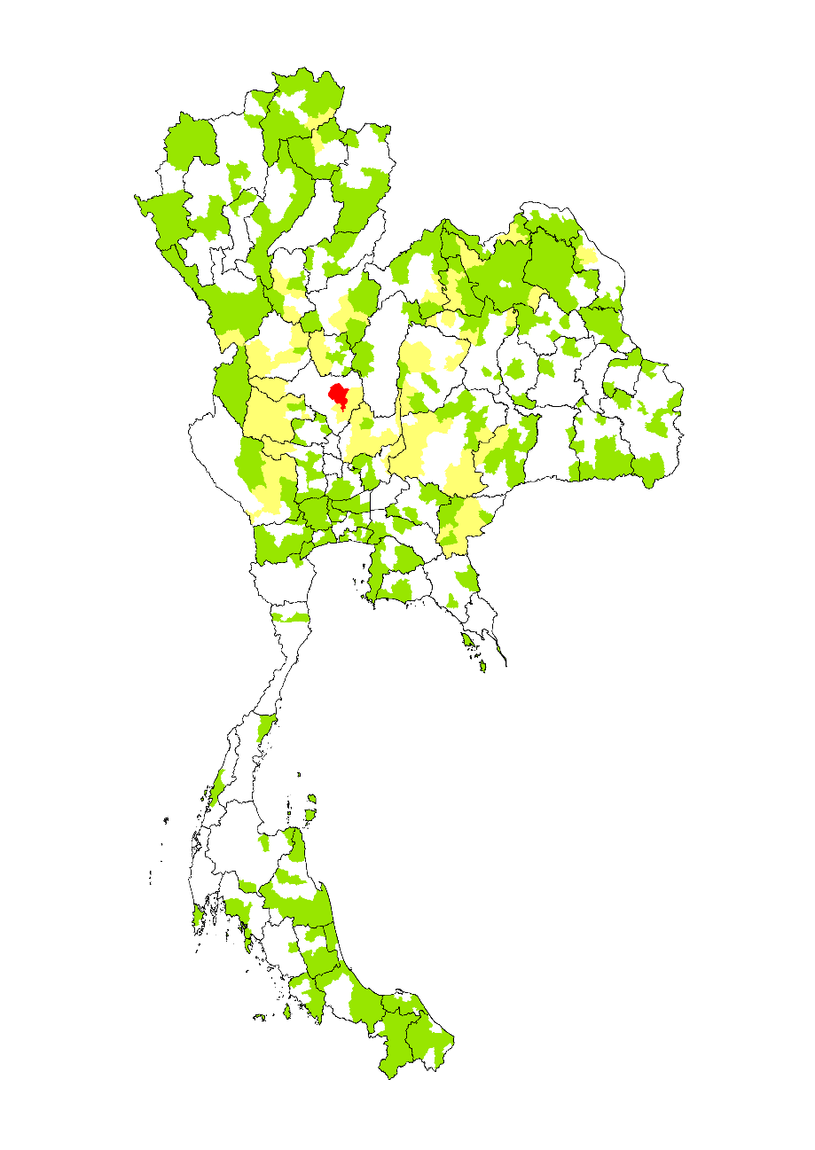

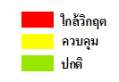
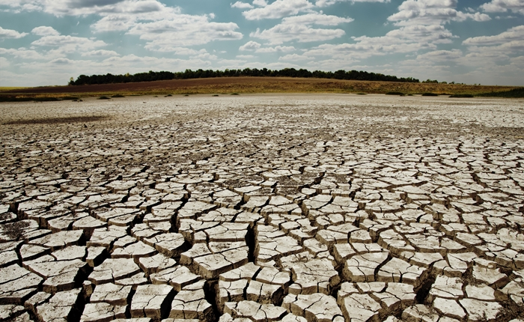
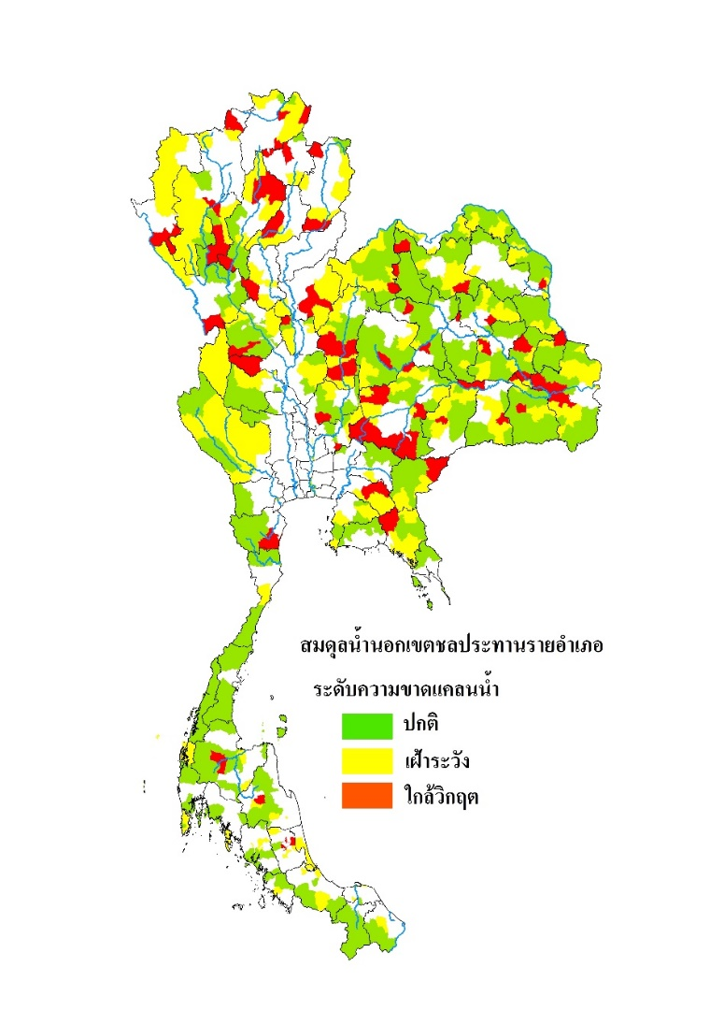
Drought-declared areas in 2017-2018
Forecast drought risk area on the agriculture sector in 2017-2018 Between March and April 2018
23 provinces 74 districts
No drought area
Drought Levels
628
0 – 2 mcm
226
Watching
2 – 20 mcm
73
Normal
>20 mcm
1
Crisis

Slide 12
Additional
Precipitation during the dry season was 54% (270.8 mm.) above the seasonal average in 2017 - 2018.
Drought had not occurred as expected (23 provinces 74 districts) because the amount of water was in the normal level.
Water allocation and rice cultivation was operated in accordance with the plan.
Chao Phraya River, Mae Klong and Prachin – Bangpakong has the salinity level within the normal range.

Slide 13
Flood Management in 2018

Slide 14
Flood management in Thailand
Flash Flood
Flood
Problems
Problems
Total rainfall was above average with repeated events
Drainage system can not due with flash flood
Land use change
The size of the reservoir is mostly small and medium
Effects of sea level rise
Most of flood area located outside the irrigated area.
Stagnant water can lead to water quality problem
It is difficult to drain water out of floodplain
Problem solving
Problem solving
Short term: Increase drainage capacity by pump
Long term: Improve drainage system
Management plan: Flash flood guidance system
Short term: Increase drainage capacity by pump
Long term: Structural measure such as flood bypass
Management plan: Develop flood plain and retention areas

Slide 15
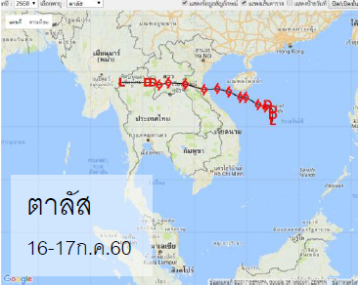

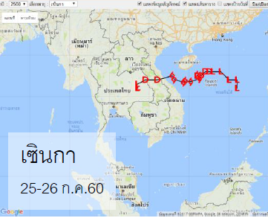
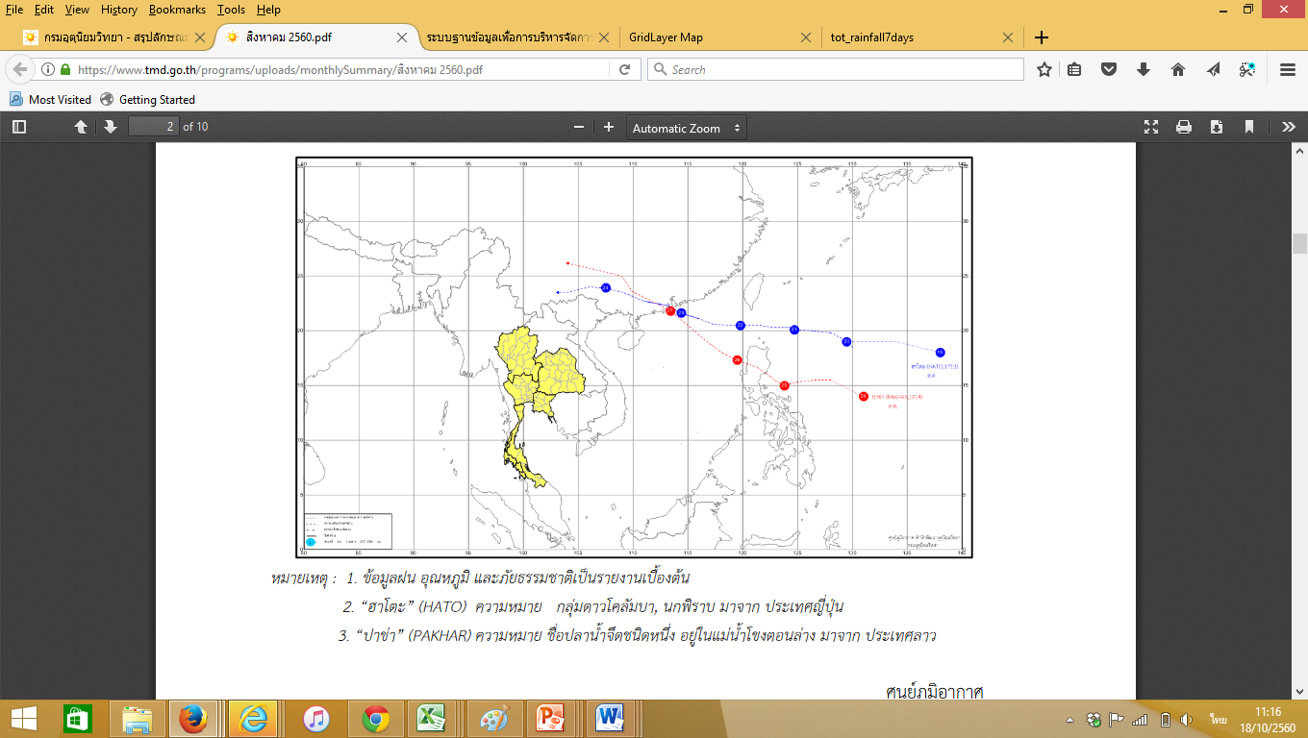
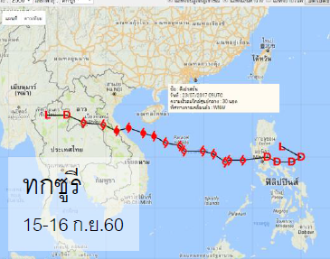

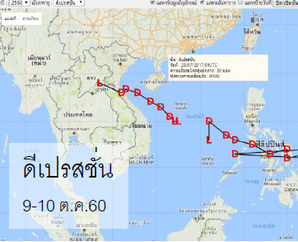
Storm route monitoring and tracking
Forecasting
1. Tropical Storm “Talas”
Move to Thailand in Nan province on July 17, 2017
End
Start
2. Tropical Storm “Sonca”
Move to Thailand in Nakhon Phanom province on July 26, 2017
End
Start
End
3. Typhoon “Hato”
4. Tropical Storm “Pakhar”
Did not move to Thailand.
Indirect impact
Start
5. Typhoon “Doksuri”
Move to Thailand in Bueng Kan province
on September 15, 2017
End
Start
End
6. Depression Storm
Low pressure covered the Northern Thailand on October 10, 2017
Start
Source : Thai Meteorological Department

Slide 16
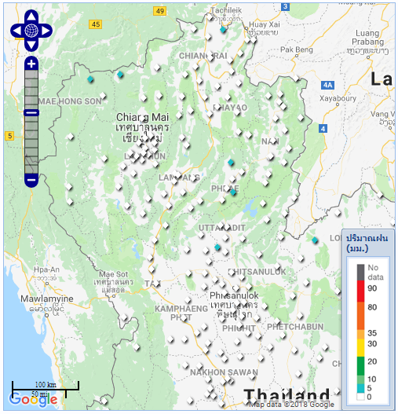

Rainfall monitoring station

Slide 17
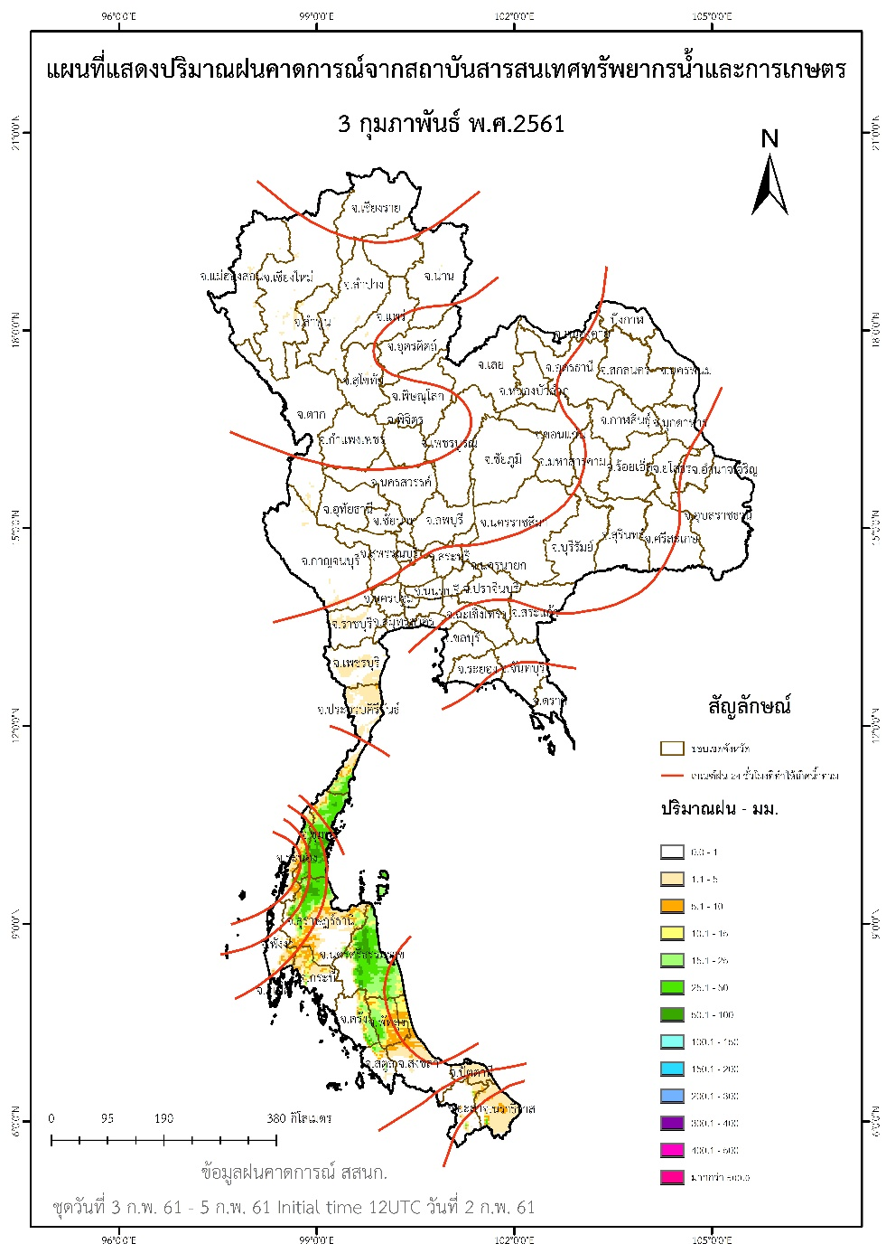
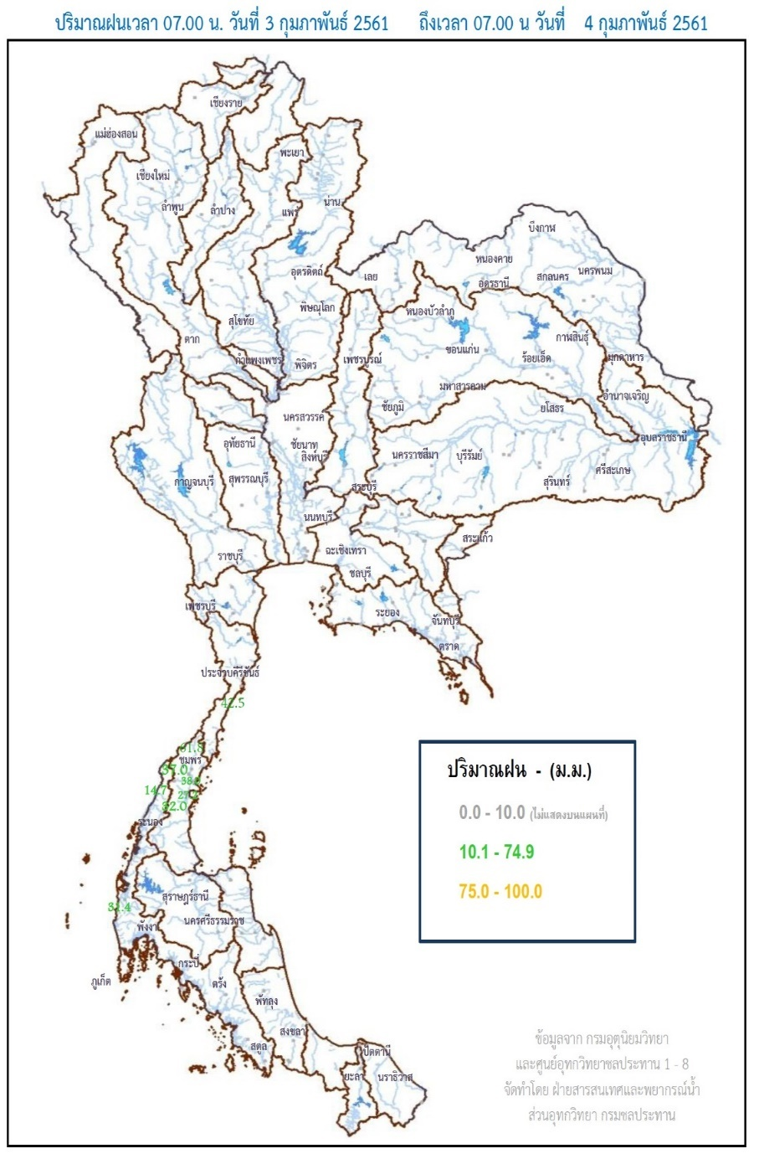
Forecasting and assessing water situation
Observation
Forecasting

Slide 18
Command
National Disaster Prevention and Mitigation Plan
"Water Management and Flood Management"

Slide 19
Severity of Flood , Level 3 (Large Disaster)
Large Flood: has severe damage that affected to the large public area beyond the control of Provincial Emergency Operation Center (PEOC) (Governor : Director of PEOC) or Bangkok Metropolitan Administration Emergency Operation Center (BMA EOC) (BMA Governor : Director of BMA EOC). The situation requires sorts of specialists/special equipment/supports from all sectors to countermeasure emergency/disaster mitigation. Director of Central Emergency Operation Center (Director General of DDPM) or Commander of National Emergency Operation Headquarter (Minister of Interior) shall be in charge to control and command the situation.
Office of National Water Resources (ONWR)
Data Support
Warning
National Emergency Operation Headquarter (NEOH)
Commander of NEOH (Minister of Interior)
Provincial Command Center
Bangkok Metropolitan Administration Command Center
Provincial Emergency Operation Center (PEOC) (76 provinces)
Bangkok Metropolitan Administration Emergency Operation Center (BMA EOC)
Governor : Director of PEOC
BMA Governor : Director of BMA EOC
District Emergency Operation Center (DEOC)
(878 Distrcts)
BMA District Emergency Operation Center (BMA DEOC) (50 Distrcits)
District Chief: Director of DEOC
BMA District Chief: Director of BMA DEOC
Municipality Emergency Operation Center (MEOC)
(2,010 Municipalities)
Sub-district
Administration Office
(SAO EOC) (5,765 SAOs)
Pattaya City Emergency Operation Center
(Pattaya EOC)
Mayor: Director of MEOC
Sub-district Chief:
Director of SAO EOC
Pattaya Governor : Director of Pattaya EOC

Slide 20
Severity of Flood , Level 4 (Catastrophic Disaster)
Catastrophic Flood: has massive damage that extremely affected to life/property/living/mentality of most population. The situation is beyond the control of Director of Central Emergency Operation Center (Director General of DDPM) or Commander of National Emergency Operation Headquarter (Minister of Interior).
Prime Minister/Deputy Prime Minister has full power according to Article 44 of Disaster Prevention and Mitigation Act 2007 to control and command the nationwide situation.
Prime Minister
Single Command
Office of National Water Resources (ONWR)
Data Support
Warning
National Emergency Operation Headquarter (NEOH)
Commander of NEOH (Minister of Interior)
Provincial Command Center
Bangkok Metropolitan Administration Command Center
Provincial Emergency Operation Center (PEOC) (76 provinces)
Bangkok Metropolitan Administration Emergency Operation Center (BMA EOC)
Governor : Director of PEOC
BMA Governor : Director of BMA EOC
District Emergency Operation Center (DEOC)
(878 Distrcts)
BMA District Emergency Operation Center (BMA DEOC) (50 Distrcits)
District Chief: Director of DEOC
BMA District Chief: Director of BMA DEOC
Municipality Emergency Operation Center (MEOC)
(2,010 Municipalities)
Sub-district
Administration Office
(SAO EOC) (5,765 SAOs)
Pattaya City Emergency Operation Center
(Pattaya EOC)
Mayor: Director of MEOC
Sub-district Chief:
Director of SAO EOC
Pattaya Governor : Director of Pattaya EOC

Slide 21
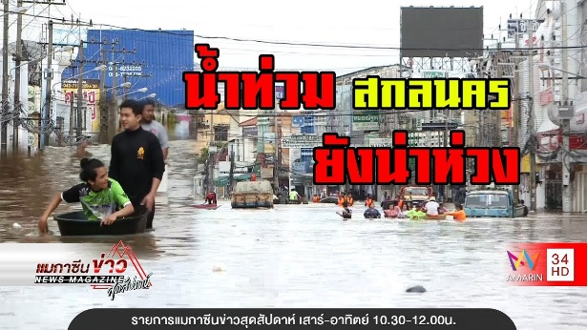
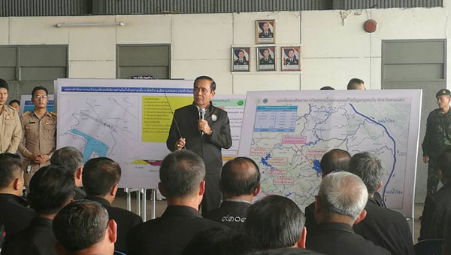
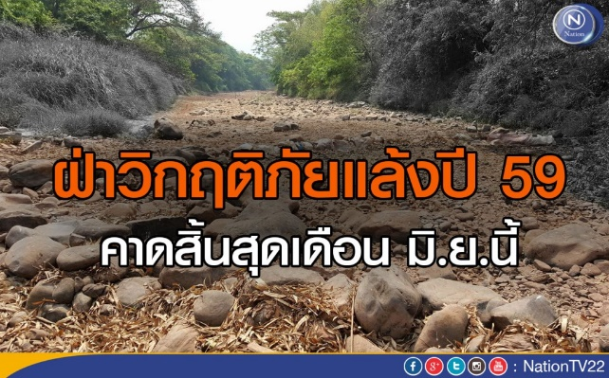
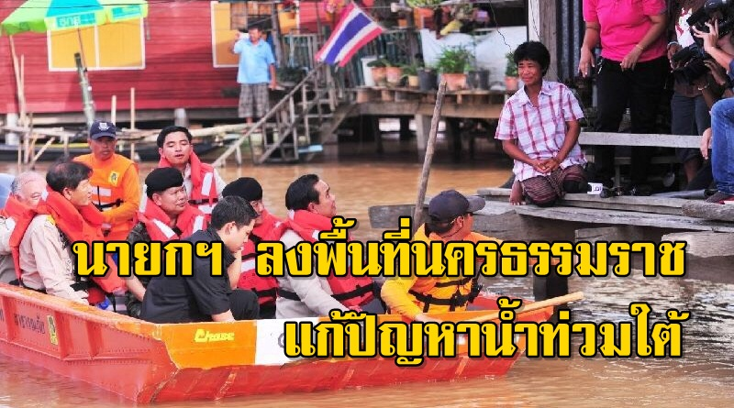
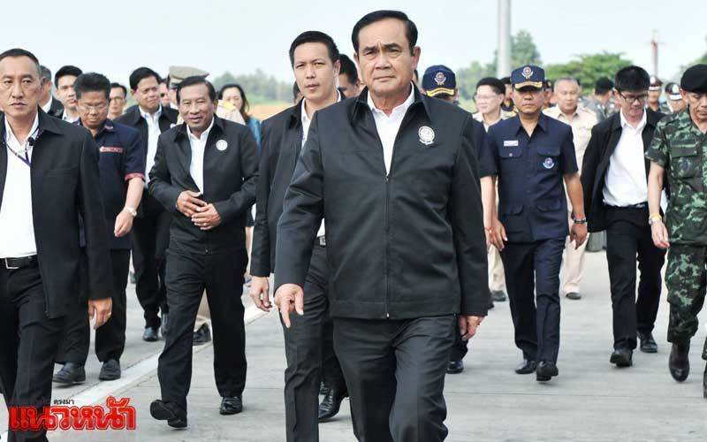
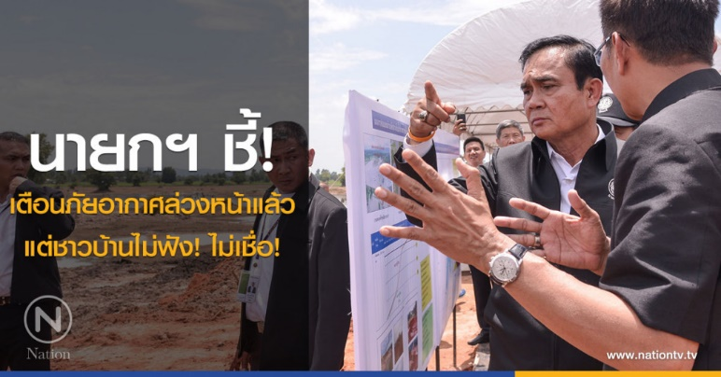

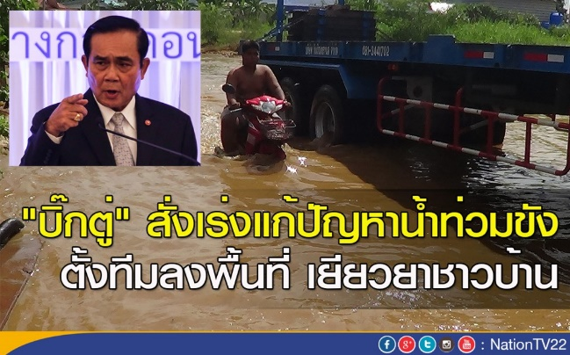
Stakeholder engagement within water resource management

Slide 22
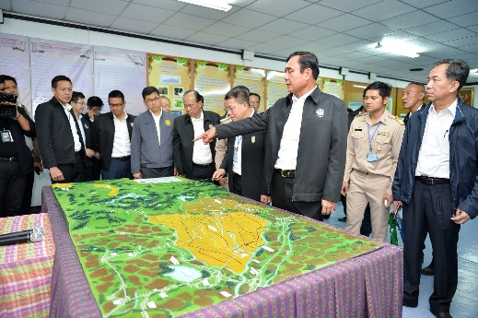
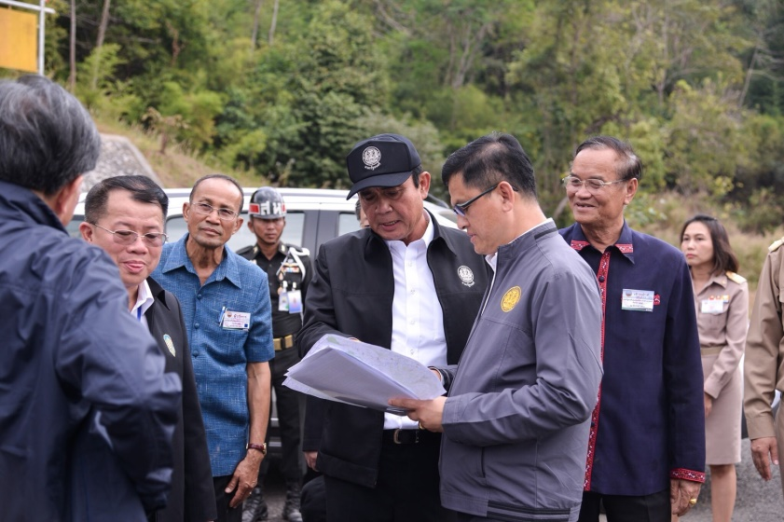
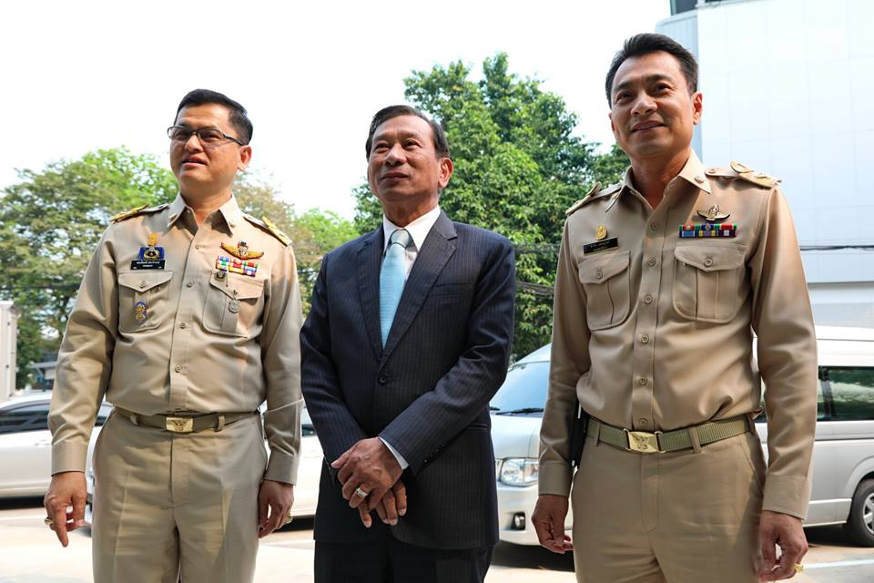
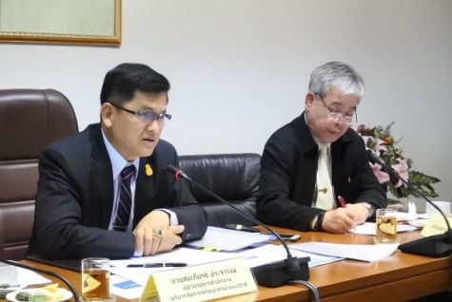
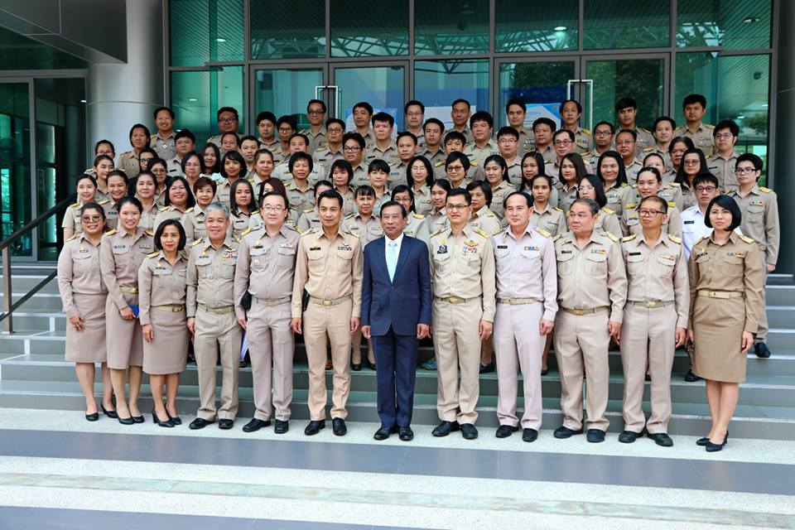
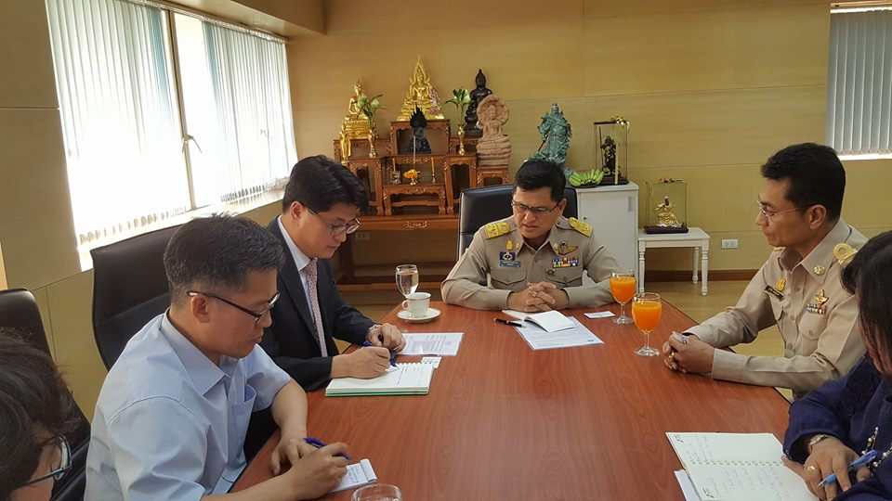
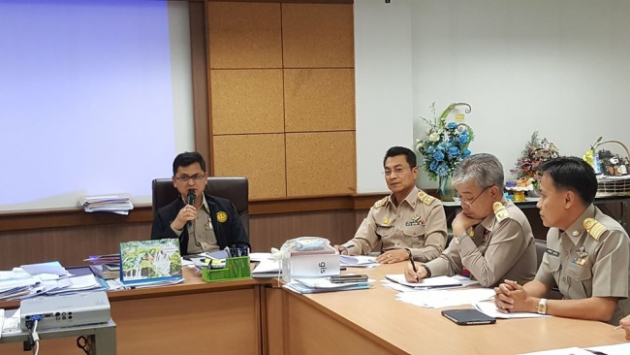
Office of the National Water Resources

Slide 23
THANK YOU
FOR YOUR ATTENTION

